Slide 1
Hand Gestures classification
Pol Casacuberta
He Chen
Eric Hurtado
Tommaso Patriti
Alexandru-Ilie Popa

Slide 2
Outline
Description of the problem
Description of the dataset
Data Analysis
Evaluation Criteria
Machine Learning methods
Conclusions
Eric Hurtado

Slide 3
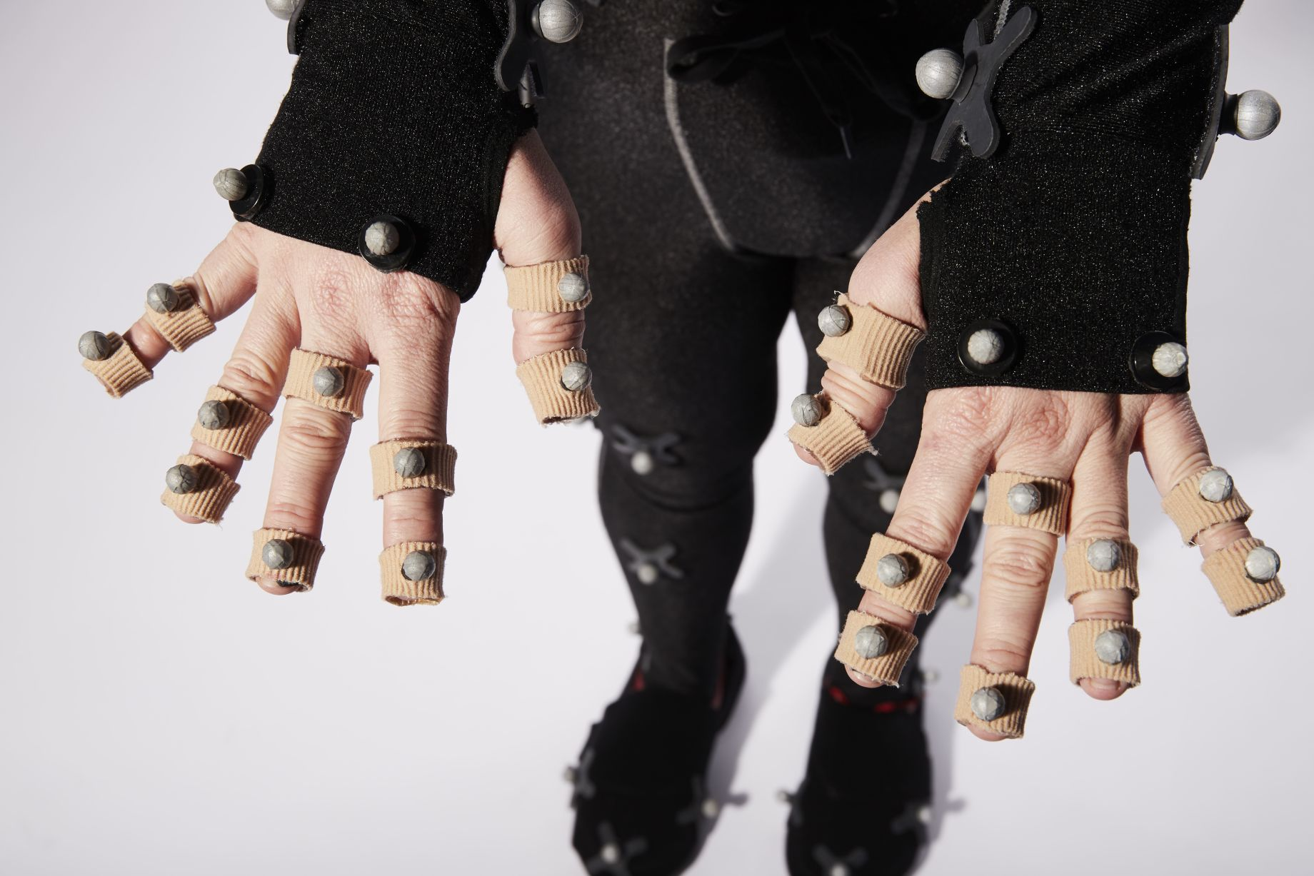
Description of the problem
Objective: Develop predictive models that can determine the user who makes the movement.
Eric Hurtado

Slide 4

Description of dataset
Hand postures
- markers on the fingers
- undergone preprocessing steps.
- 12 markers
- Xi, Yi, Zi
- 5 Class (Postures)
- 14 Users
12 markers
Xi, Yi, Zi
5 classes (postures)
14 user
In total we have:
38 columns
78096 rows
2 categorical and 36 numerical variables

Slide 5
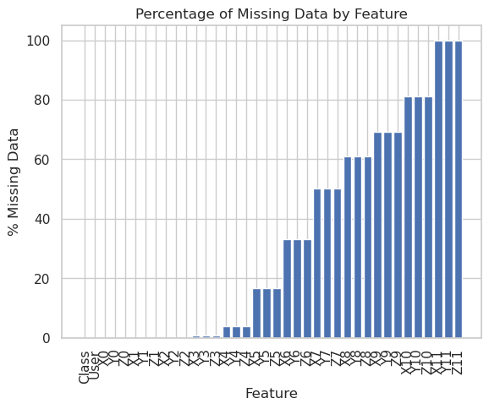
Missing data analysis
Starting from marker 3, missing data increases as the marker number increases.
self-occlusion and artifacts

Slide 6
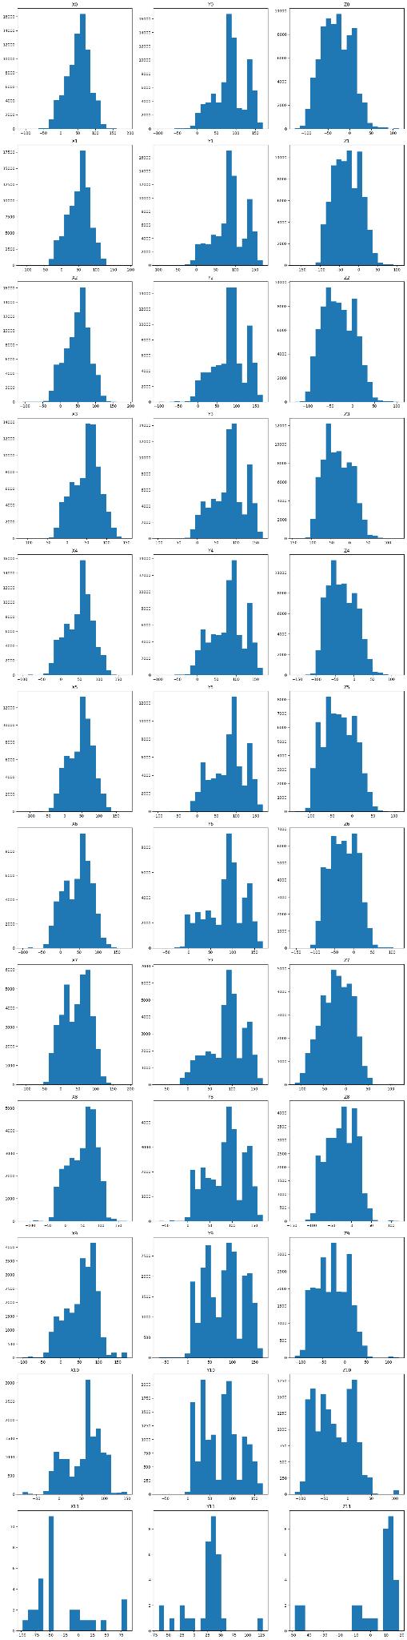
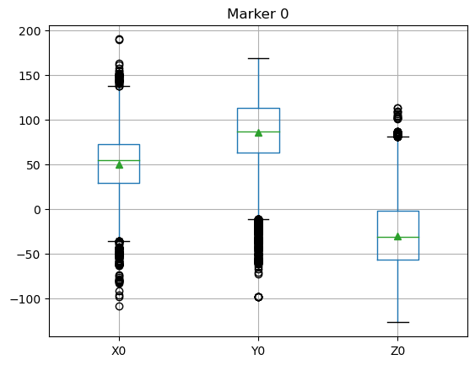
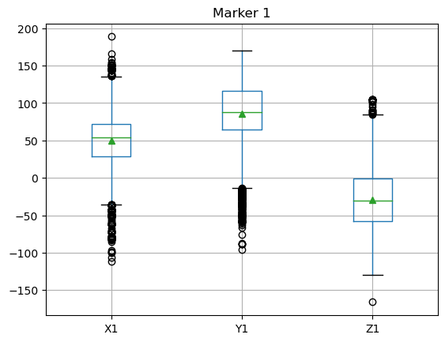
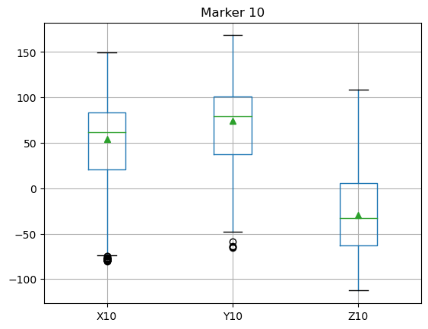
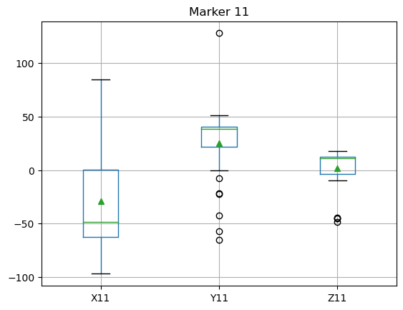
Features distribution

Slide 7
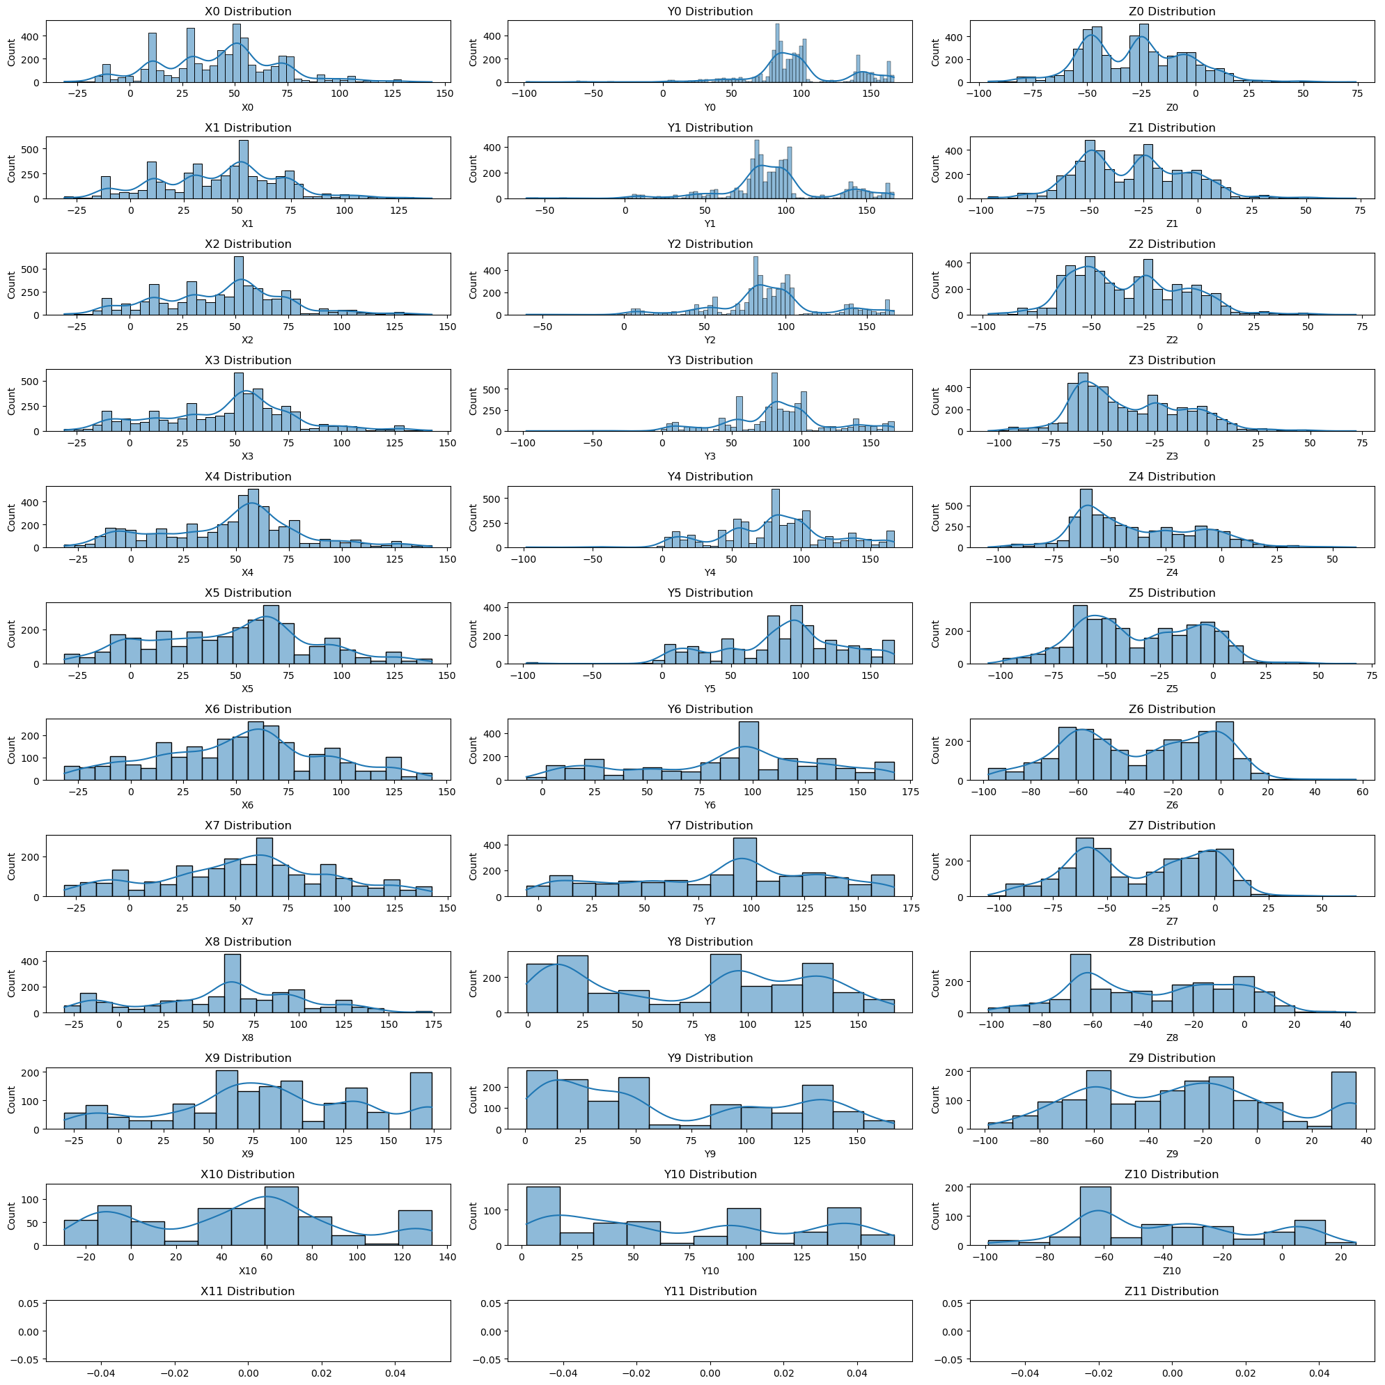
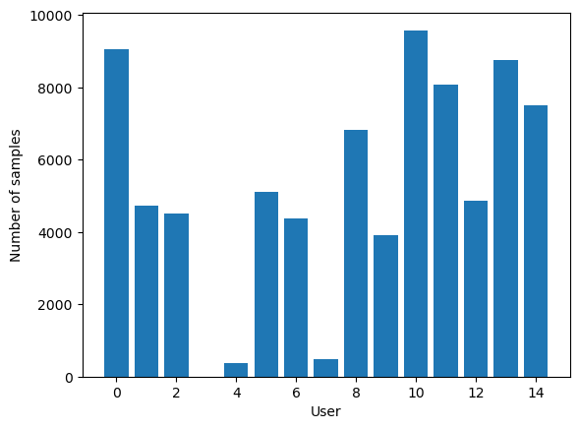
Analisis depending on label

Slide 8
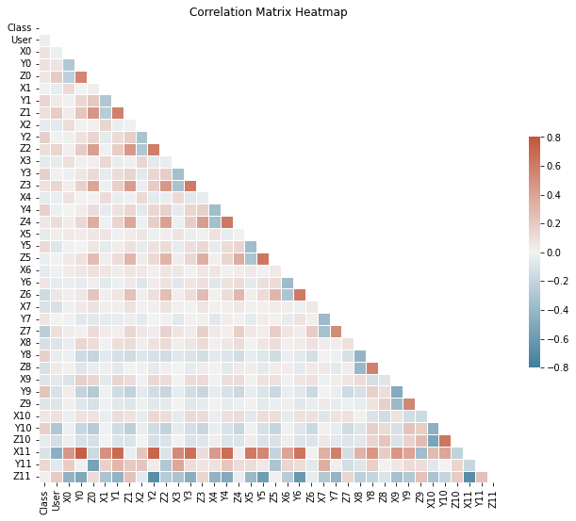
Bivariate Analysis - Correlation Heat Map
Alexandru-Ilie Popa

Slide 9
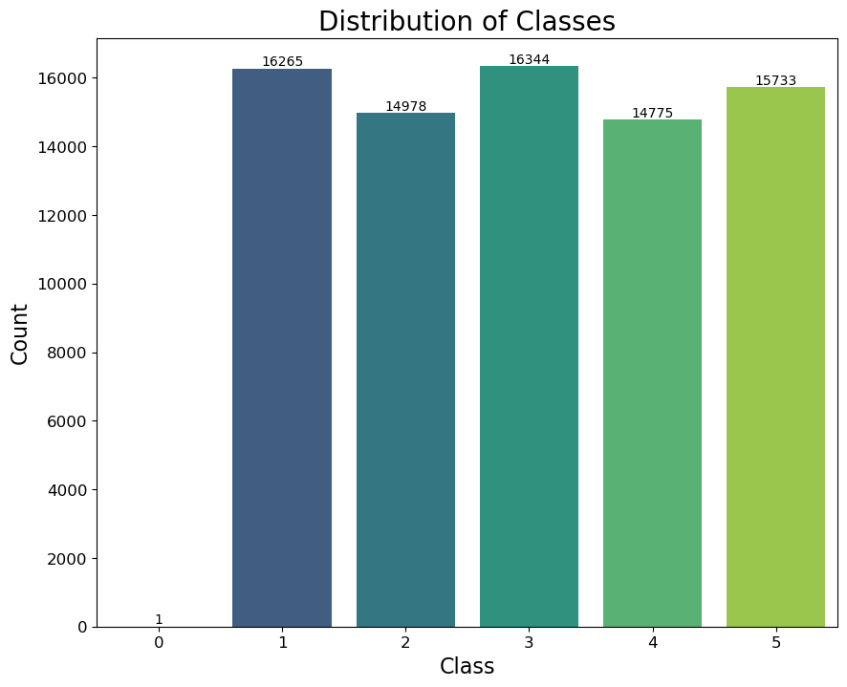
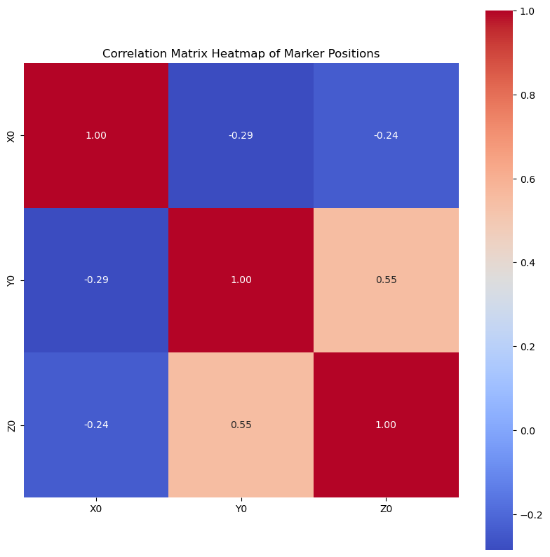
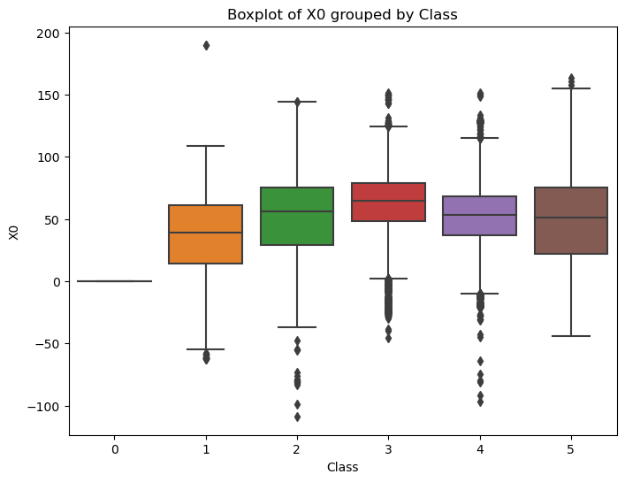
Class Distribution, Marker Positions & Marker Heat Map
Alexandru-Ilie Popa

Slide 10
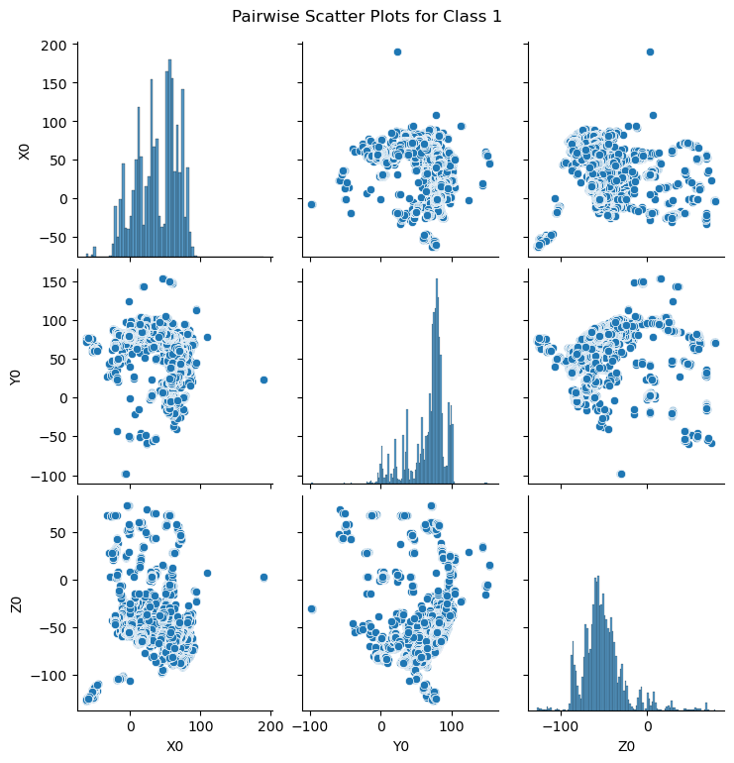
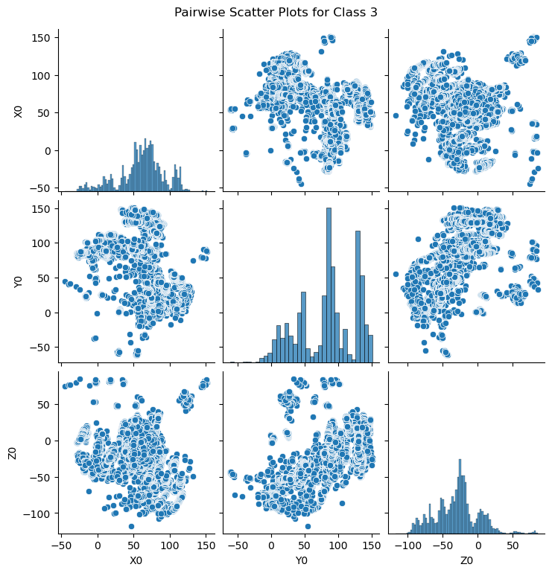
Scatter Plots & Conclusions
Alexandru-Ilie Popa

Slide 11
Evaluation criteria of data mining models
Accuracy
precision
recall
f1 score
Cross validation k-fold (k=5)
Pol Casacuberta

Slide 12
Naïve Bayes
FIT
acc | prec | recall | f1 score
0.3823 | 0.3946 | 0.3823 | 0.3474
CROSS VALIDATION
acc | prec | recall | f1 score
0.2359 | 0.2797 | 0.2359 | 0.2135
Eric Hurtado

Slide 13
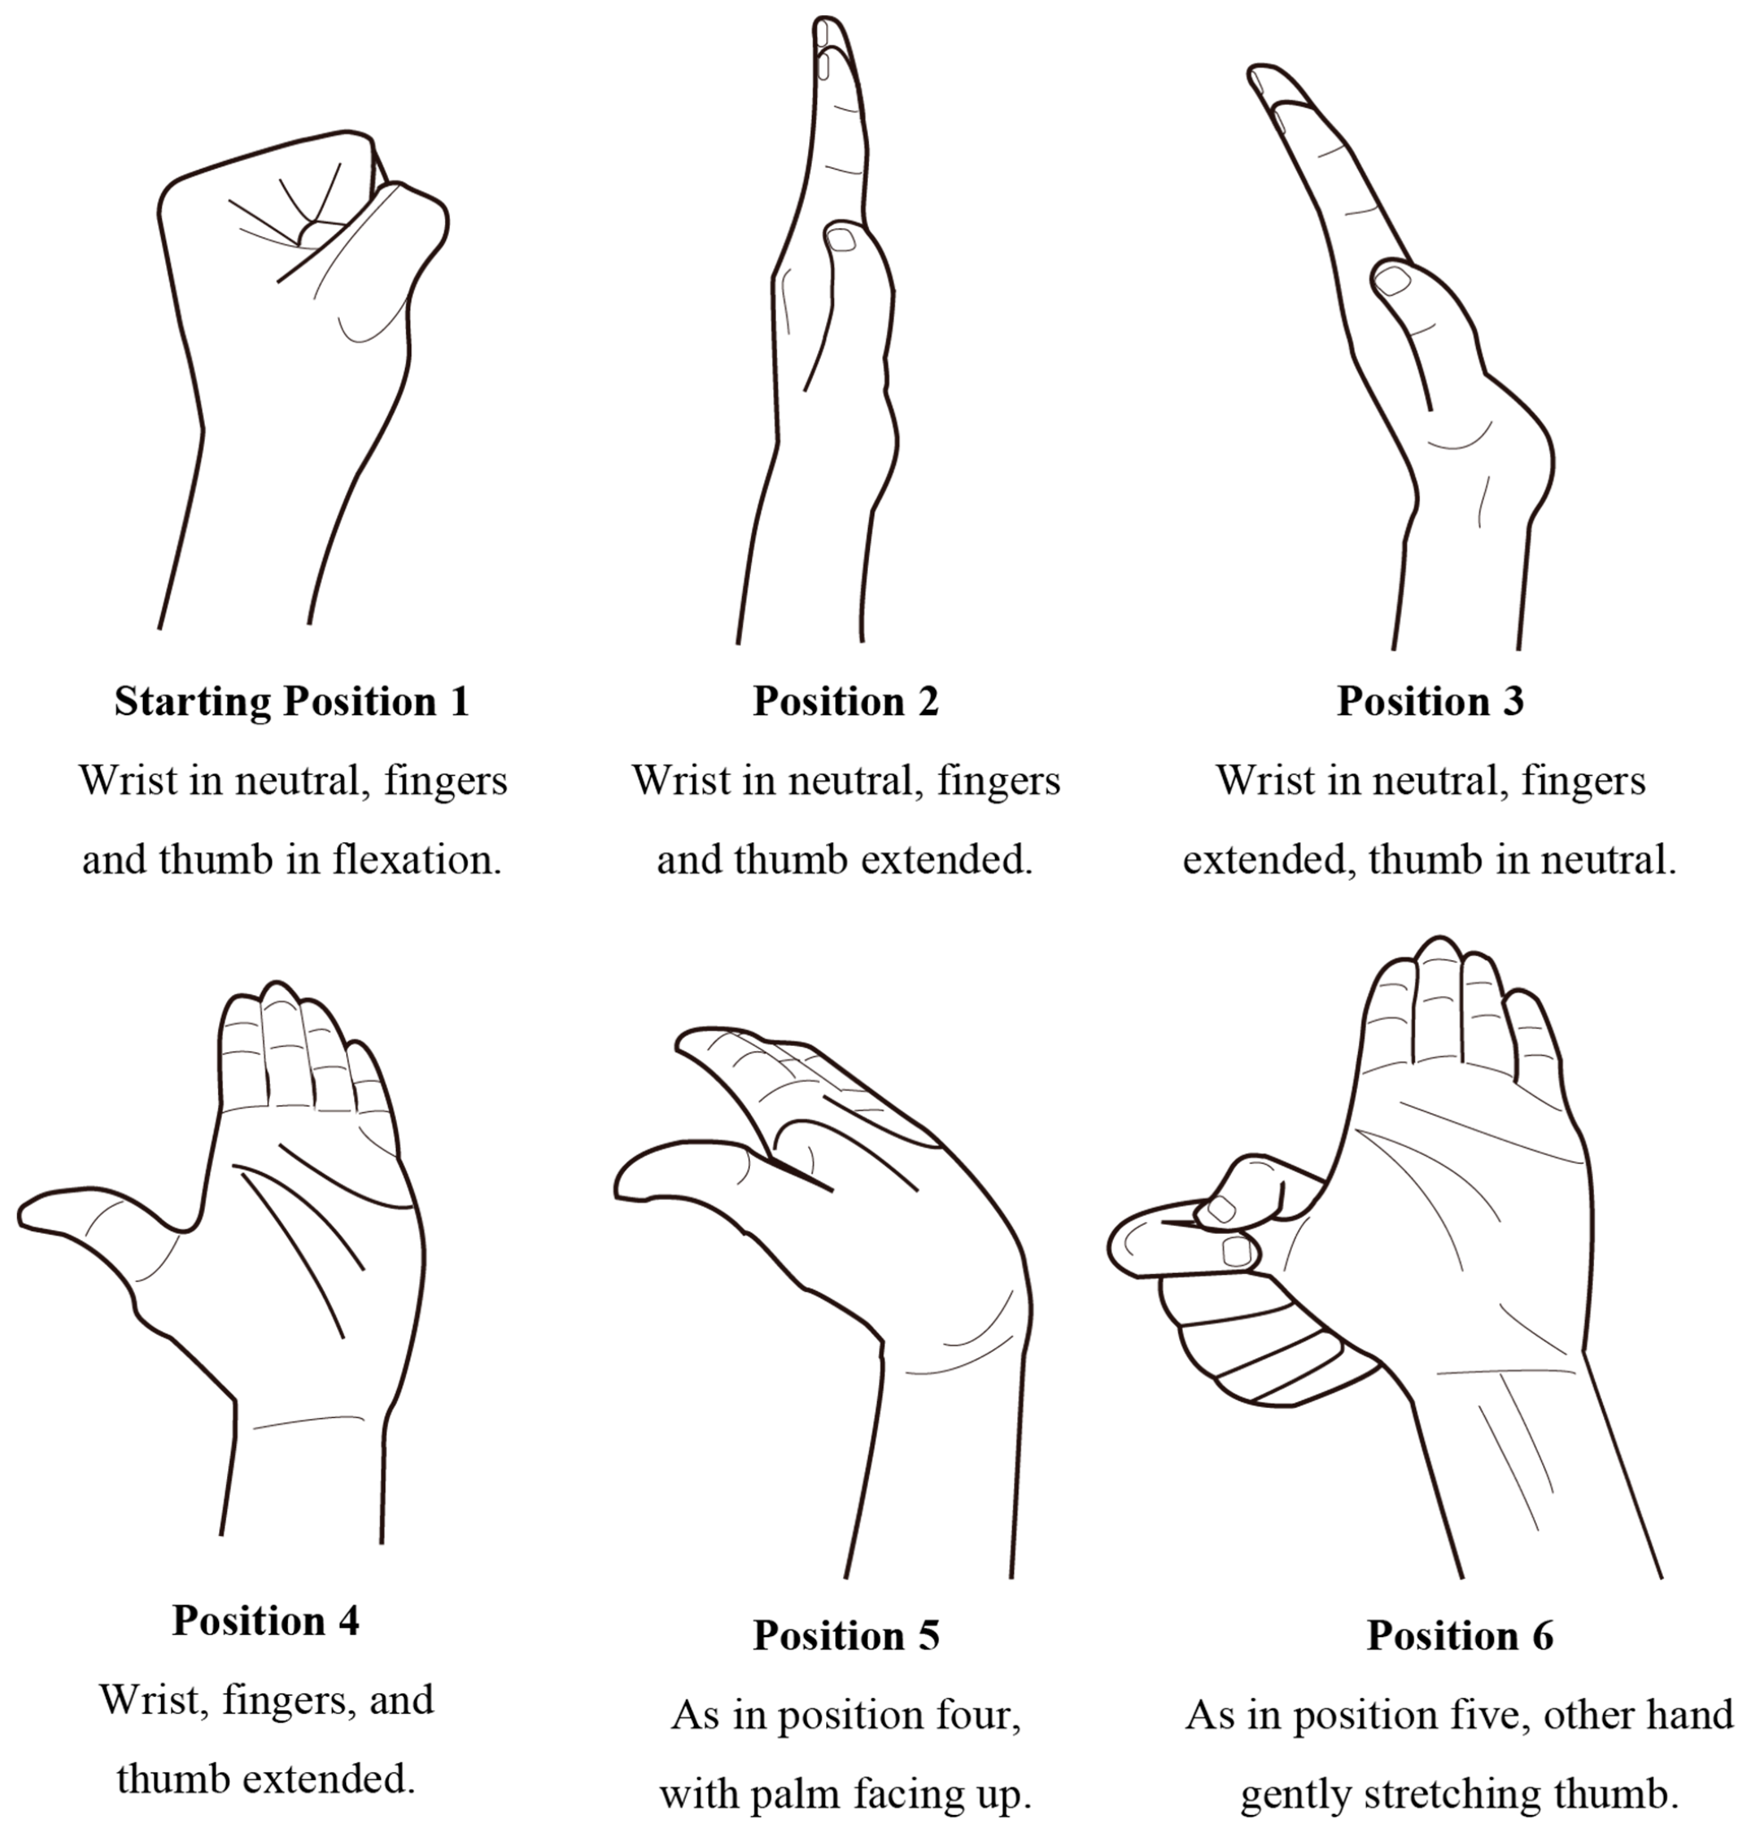
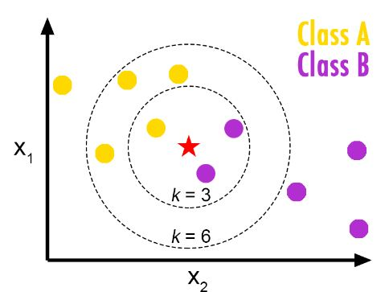
Introduction to K-NN
Alexandru-Ilie Popa

Slide 14
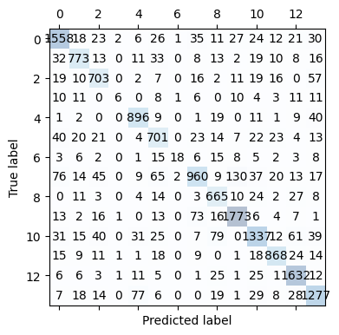
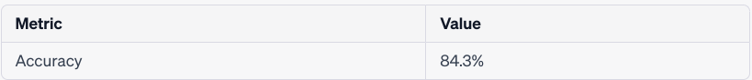
Basic K-NN Model and Simple Cross-Validation
Alexandru-Ilie Popa

Slide 15
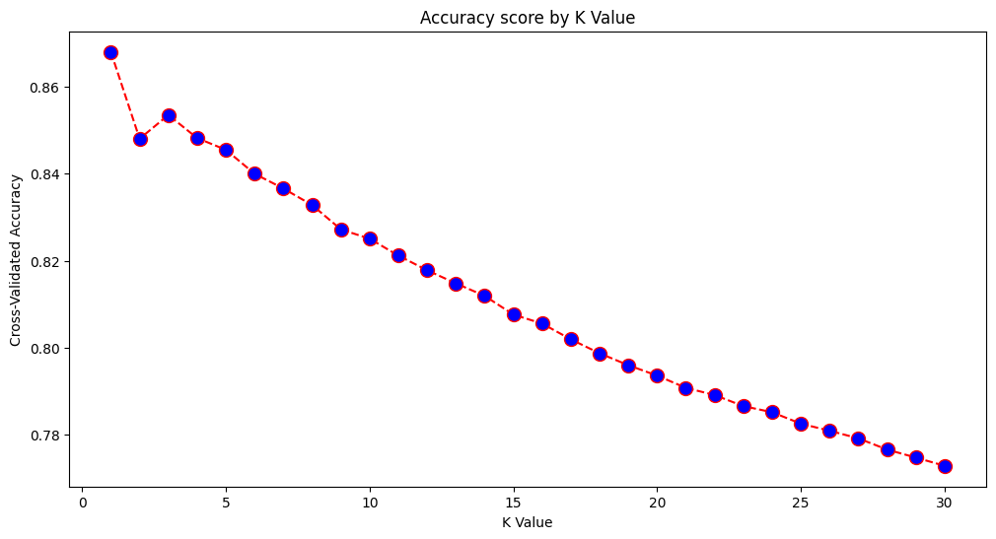
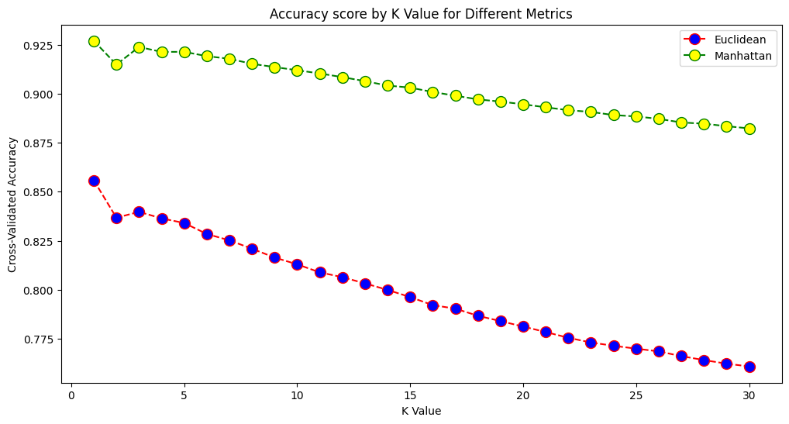
Effects of K and Different Metrics
Alexandru-Ilie Popa

Slide 16
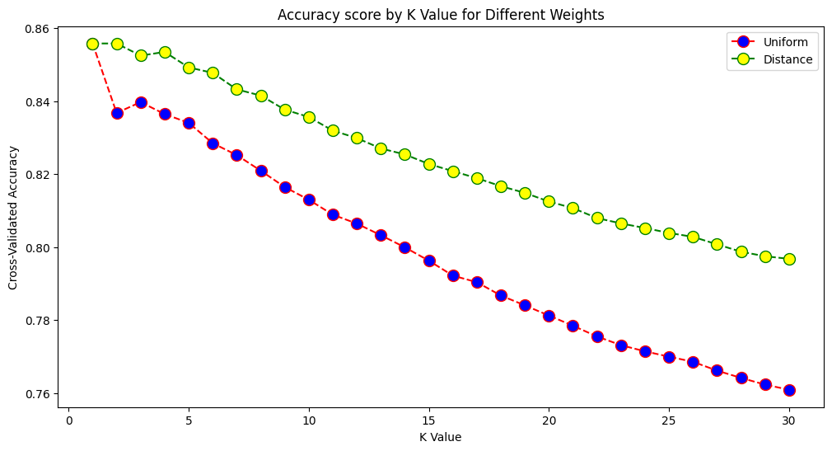
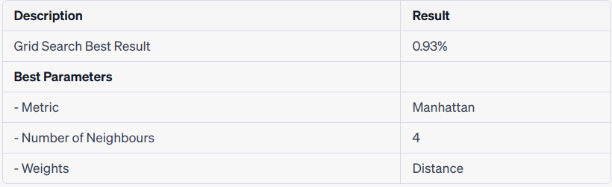
Effect of Weighting and Grid Search Results
Alexandru-Ilie Popa

Slide 17
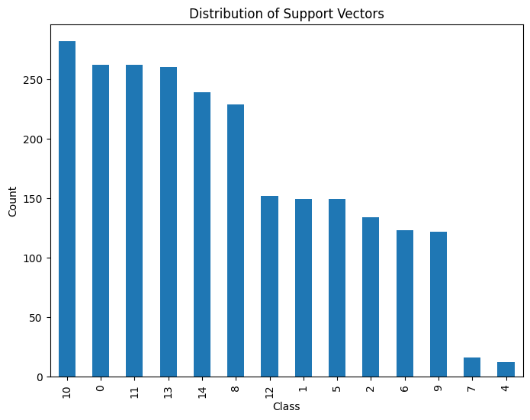
Support Vector Machines
2383 support vectors
Best parameters {'C': 10, 'gamma': 0.0001, 'kernel': 'rbf'}
Parameters tried:
C: 1,10,100,1000
Gamma: 1, 0.1, 0.001, 0.0001
Kernel: rbf, sigmoid
Pol Casacuberta

Slide 18
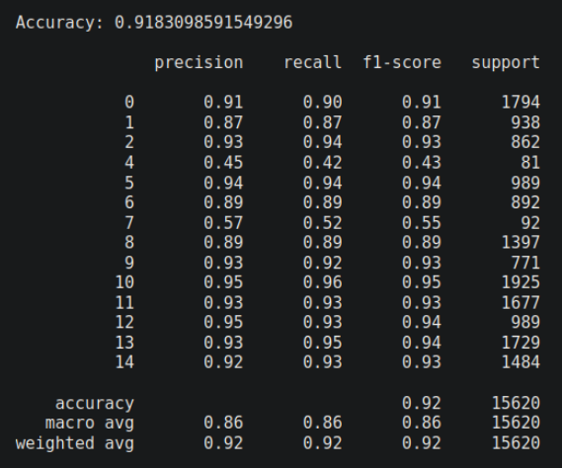
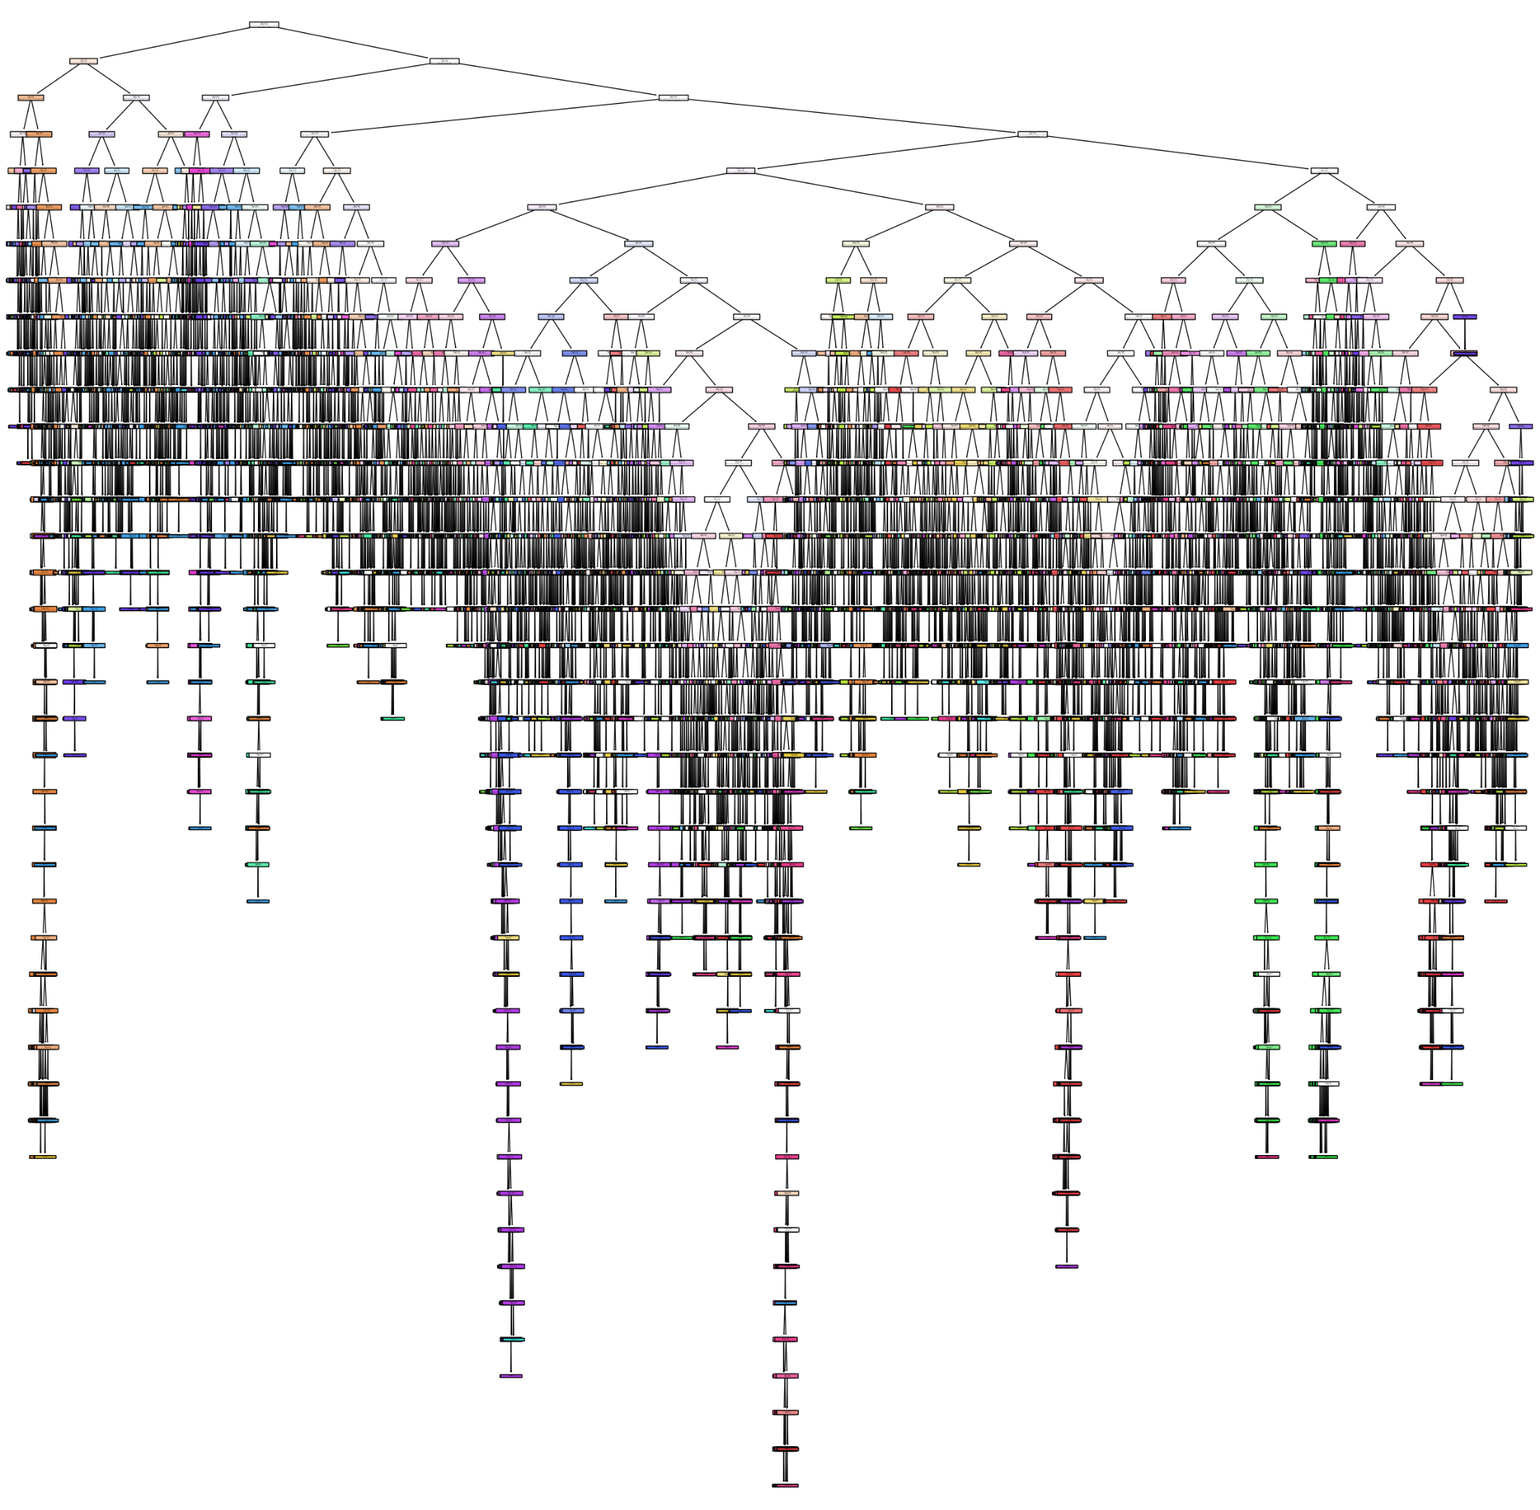
Decision trees - default values
4297 leaf nodes

Slide 19
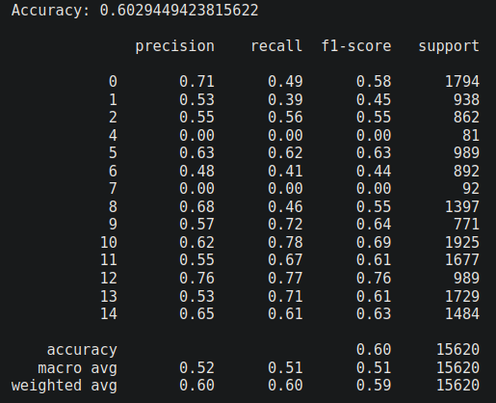
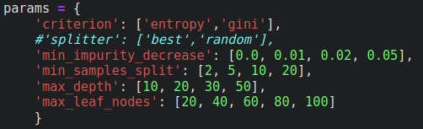
Decision trees - improving
criterion | entropy
max_depth | 20
max_leaf_nodes | 100
min_impurity_decrease | 0.0
min_samples_split | 2

Slide 20
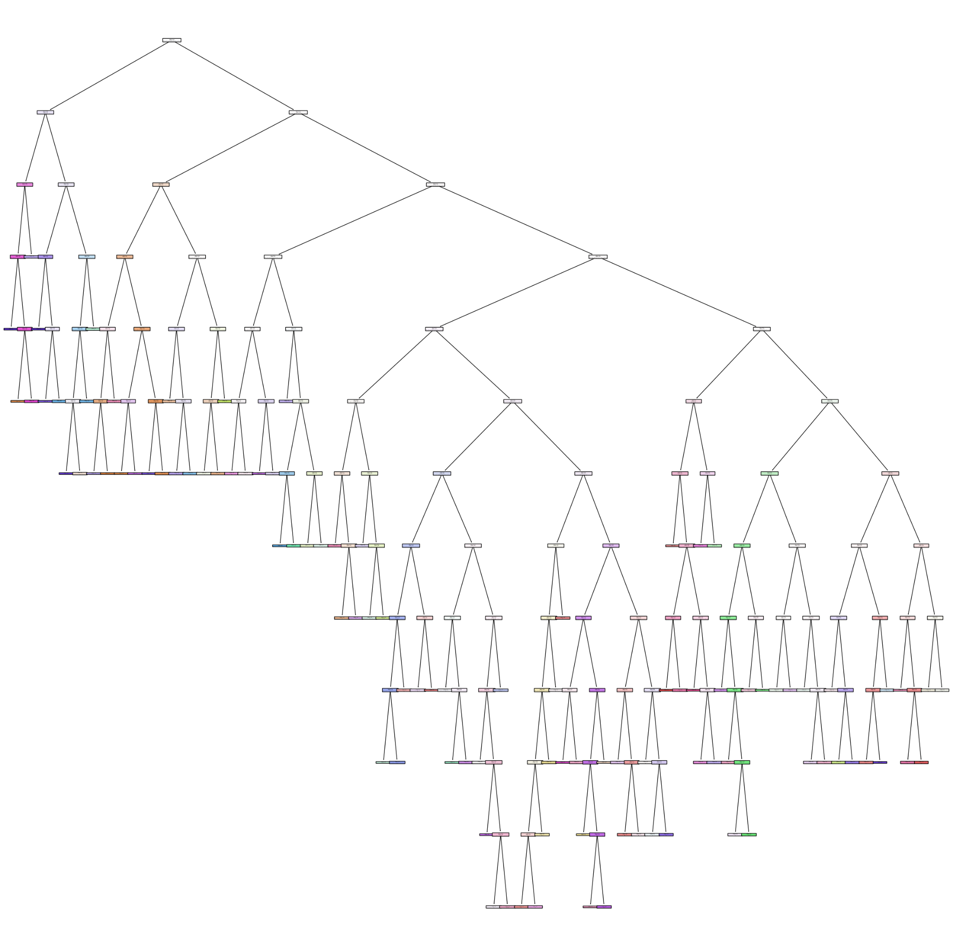
Decision trees - improving
Number of leaves in the decision tree: 100
the accuracy has decreased compared to the default version, from 0.91 to 0.60.
the number of leaves has decreased compared to the default version, from 4000 to 100.

Slide 21
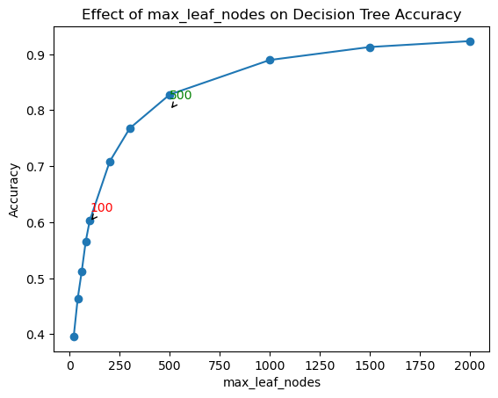
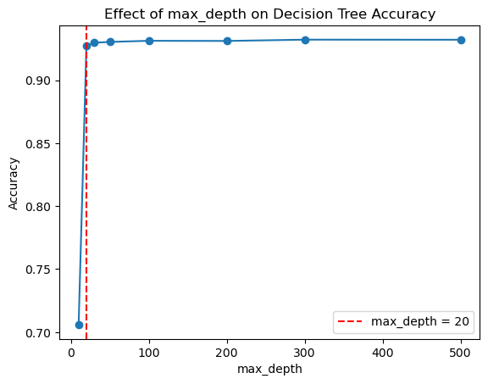
Decision trees - stats

Slide 22
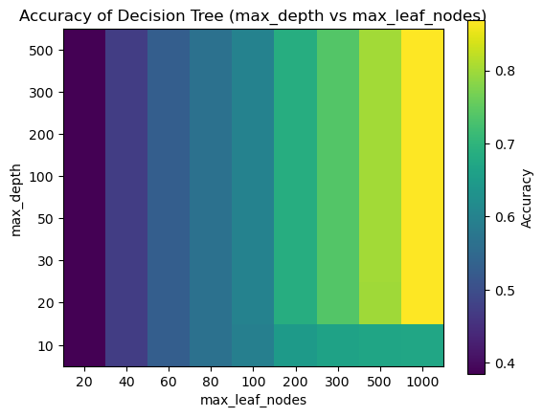
Decision trees - stats
- How get accuracy 0.7?
max_leaf_node = 200
max_depth = 20

Slide 23
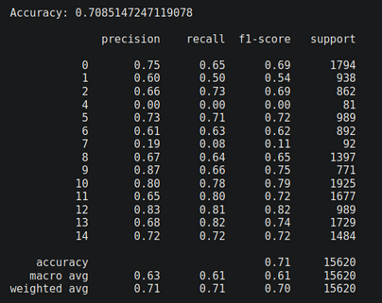
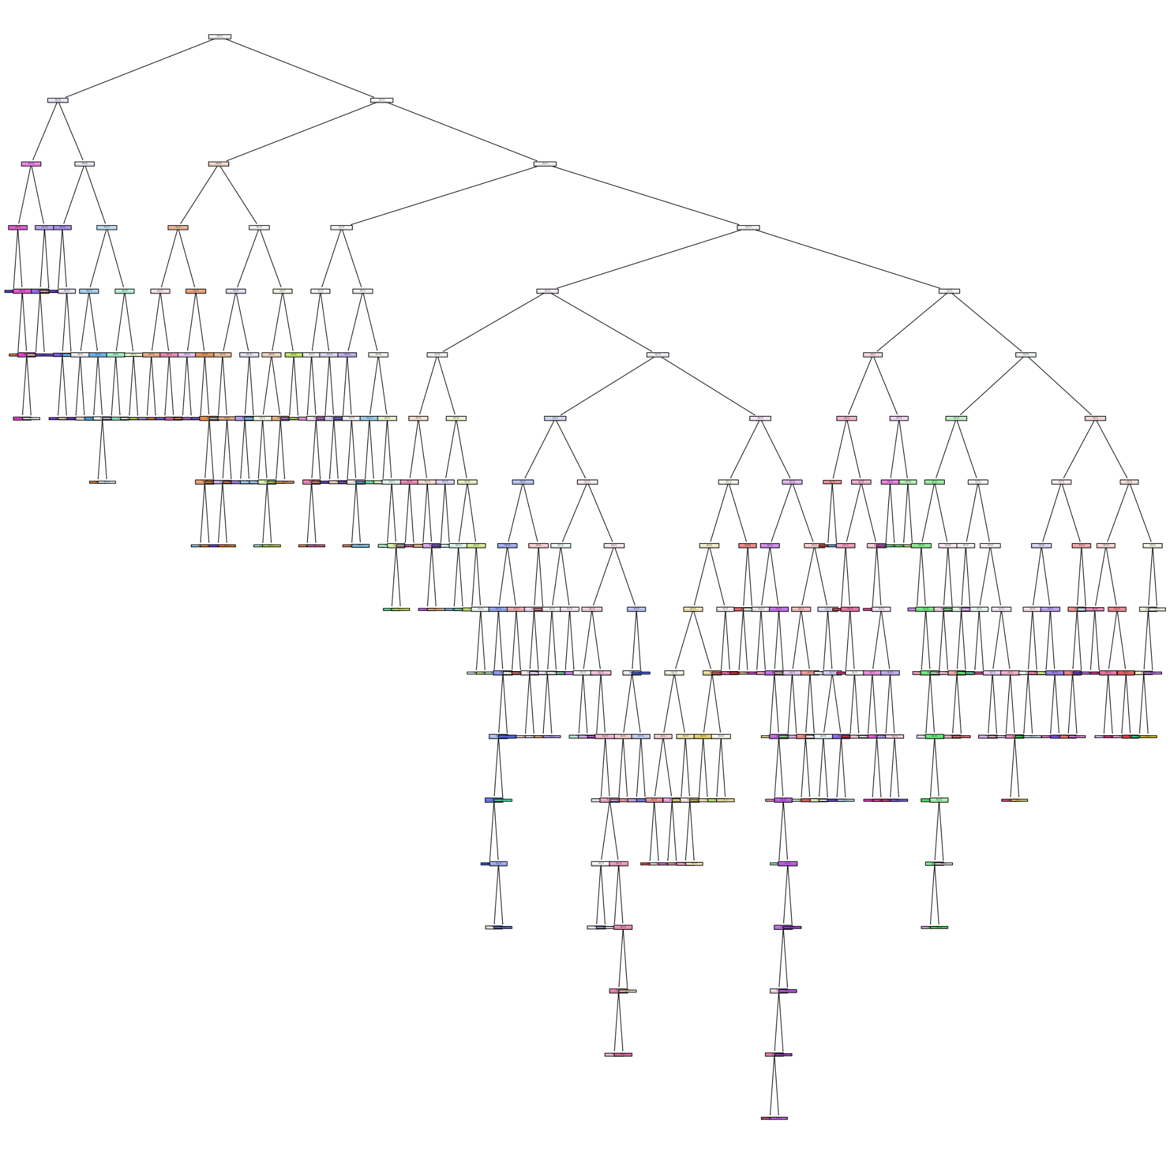
Decision trees

Slide 24
Meta-learning algorithms
 | acc | prec | recall | test f1 score (W)
majority_vote | 0.989821 | 0.989856 | 0.989821 | 0.949099
AdaBoost | 0.989757 | 0.989702 | 0.989757 | 0.950960
Random Forest | 0.982714 | 0.982614 | 0.982714 | 0.926240
Bagging | 0.966197 | 0.965651 | 0.966197 | 0.915705
majority_vote 2 | 0.917990 | 0.917158 | 0.917990 | 0.857498
Tommaso Patriti

Slide 25
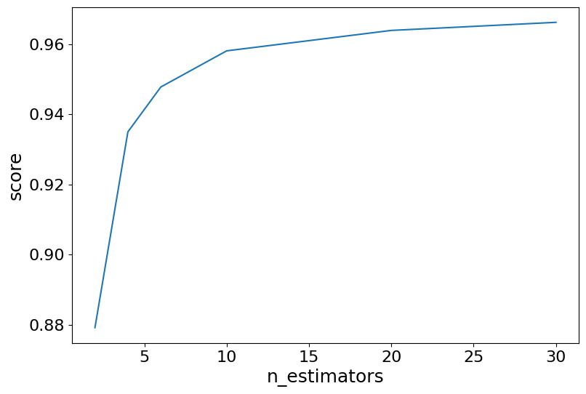
Bagging
acc | prec | recall | test f1 score (W)
0.966 | 0.965 | 0.966 | 0.915
BaggingClassifier(n_estimators = 30)
Tommaso Patriti

Slide 26
Random Forest
RandomForestClassifier(
max_depth=200,
max_features=4,
n_estimators=200)
acc | prec | recall | test f1 score (W)
0.982714 | 0.982614 | 0.982714 | 0.926240
Tommaso Patriti

Slide 27
Adaboost
AdaBoostClassifier(
n_estimators= 200,
estimator = decision_tree,
learning_rate= 1)
acc | prec | recall | test f1 score (W)
0.989757 | 0.989702 | 0.989757 | 0.950960
Tommaso Patriti

Slide 28
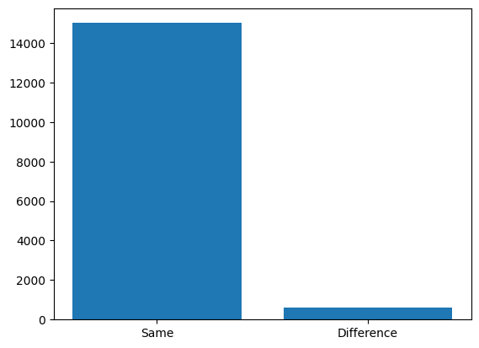
Majority Voting
acc | prec | recall | test f1 score (W)
0.989821 | 0.989856 | 0.989821 | 0.949099
Tommaso Patriti

Slide 29
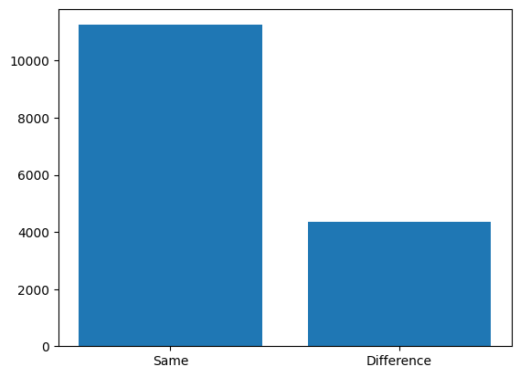
Majority Voting
 | acc | prec | recall | te. f1 (W)
Decis. tree 1 | 0.86 | 0.86 | 0.86 | 0.79
KNN | 0.86 | 0.86 | 0.86 | 0.79
Decis. tree 2 | 0.86 | 0.86 | 0.86 | 0.77
Tommaso Patriti

Slide 30
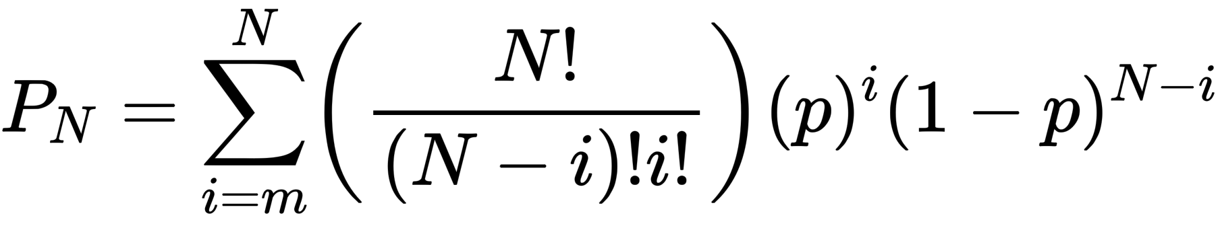
Majority Voting
 | acc | prec | recall | te. f1 (W)
Decis. tree 1 | 0.86 | 0.86 | 0.86 | 0.79
KNN | 0.86 | 0.86 | 0.86 | 0.79
Decis. tree 2 | 0.86 | 0.86 | 0.86 | 0.77
Condorcet's Jury Theorem
Tommaso Patriti

Slide 31
Majority Voting
 | acc | prec | recall | te. f1 (W)
Decis. tree 1 | 0.86 | 0.86 | 0.86 | 0.79
KNN | 0.86 | 0.86 | 0.86 | 0.79
Decis. tree 2 | 0.86 | 0.86 | 0.86 | 0.77
Condorcet's Jury Theorem
94%
Tommaso Patriti

Slide 32
Majority Voting
Condorcet's Jury Theorem
94%
acc | prec | recall | test f1 score (W)
0.917990 | 0.917158 | 0.917990 | 0.857498
Tommaso Patriti

Slide 33
Comparisons
 | acc | prec | recall | test f1 score (W)
majority_vote 2 * | 0.989821 | 0.989856 | 0.989821 | 0.949099
AdaBoost | 0.989757 | 0.989702 | 0.989757 | 0.950960
Random Forest | 0.982714 | 0.982614 | 0.982714 | 0.926240
Bagging | 0.966197 | 0.965651 | 0.966197 | 0.915705
KNN | 0.937324 | 0.936993 | 0.937324 | 0.867506
Decision Tree | 0.918 | 0.92 | 0.92 | 0.92
majority_vote 1 | 0.917990 | 0.917158 | 0.917990 | 0.857498
SVM | 0.670968 | 0.741763 | 0.670968 | 0.563378
AdaBoost
SVM Validation Accuracy: 0.6693
Cross-Validation Accuracy: 0.4419

Slide 34
Final conclusions
Z coordinates
X11 high correlation with other variables
Z11
X0-Y0 pairs through X8-Y8
X9-Y9 and X10-Y10
X11-Y11
SVM
Meta-learning algorithms
AdaBoost

